Slide 1
Everything About Time Series Forecasting
Marco Peixeiro

Slide 2
Understanding Time Series Forecasting
This chapter covers
Introducing time series
Understanding the three main components of
a time series
The steps necessary for a successful forecasting project
How forecasting time series is different from
other regression tasks
A time series is just data recorded over time.
Example: daily temperatures, stock prices, or monthly sales
By studying time series, we can understand patterns and make forecasts about the future.
This book focuses on time series forecasting in Python.
We will start with simple forecasts (basic predictions), then learn statistical models like moving averages and autoregression.
Later, we will move to advanced models that handle trends, seasonality, and outside factors.
Finally, we will explore deep learning methods, which are better for very large and complex time series.

Slide 3
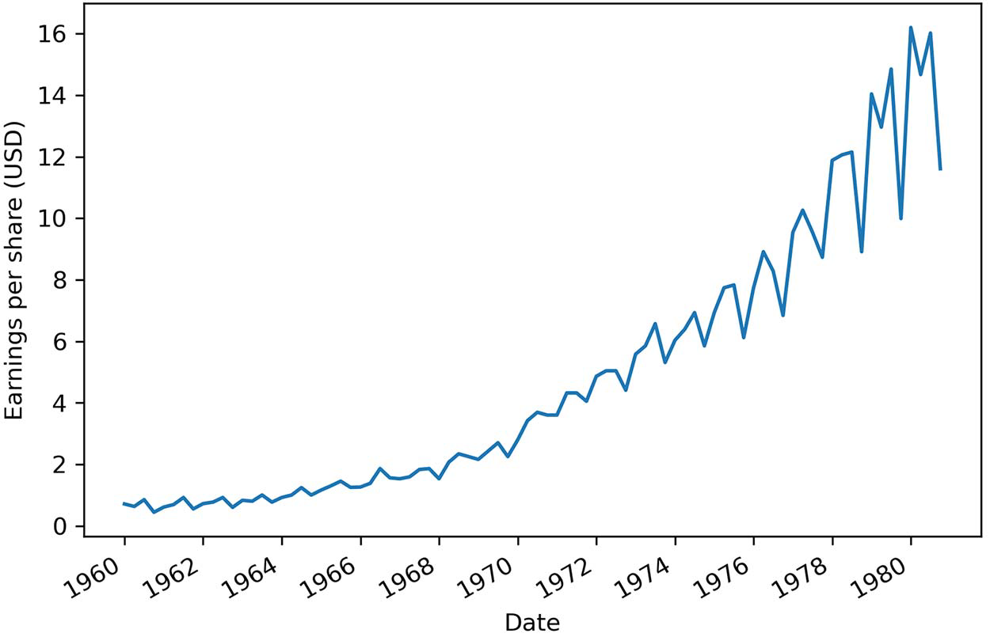
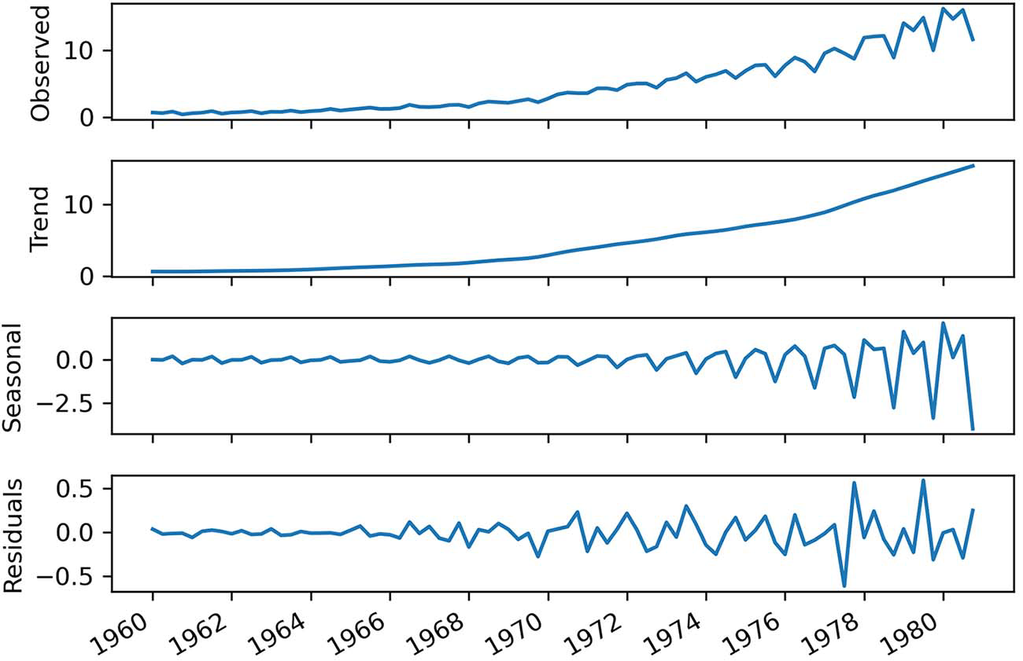
1.1 Introducing Time Series
A time series is data collected over time, in order.
The data points are usually recorded at regular intervals (like every hour, every day, every quarter).
Examples: stock prices, electricity usage, temperature.
The Johnson & Johnson dataset (1960–1980 quarterly earnings) is a good example:
The data is recorded every quarter (equally spaced).
It shows a trend (values rising over time).
It also shows seasonality (earnings go up and down in a repeating yearly pattern).
1.1.1 Components of a time series
A time series can be broken down into three parts:
Trend → The long-term direction of the data (e.g., earnings steadily increasing over years).
Seasonality → Regular repeating patterns over fixed periods (e.g., sales rising every holiday season, then dropping after).
Residuals (Noise) → Random fluctuations that can’t be explained by trend or seasonality (like unexpected events).
Decomposition is the process of splitting a time series into these parts so we can see them clearly.
In short: Time series = Trend + Seasonality + Residuals. When forecasting, we expect the trend and seasonality to continue, while residuals are unpredictable.
Focusing on the Observed plot
Focusing on the trend component
Focusing on the seasonal component
Figure 1.1 Quarterly earnings of Johnson & Johnson in USD from 1960 to 1980
showing a positive trend and a cyclical behavior
Focusing on the residuals.

Slide 4
1.2 Bird’s-eye view of time series forecasting
Forecasting means predicting the future using past data. Before building a model, there are several important steps:
Set a goal: Decide what you want to predict
Define what to forecast: Pick the exact variable
Set the forecast horizon: How far ahead you need predictions
Gather data: Collect past records
Build a model: Choose a method based on the data:
Simple statistical models (like SARIMA) for trends/seasonality.
SARIMAX if external factors matter (like wind, humidity).
Deep learning if you have lots of data.
Evaluate model: Test the model using recent data and measure accuracy (e.g., MSE).
Deploy the model → Put it into use so it can automatically give forecasts (via API, app, or even Excel).
Monitor performance → Compare forecasts with real outcomes, watch for unexpected events
Update with new data → Retrain the model with fresh data to keep forecasts accurate.
1.3 How time series forecasting is different from other regression tasks
In regular regression, the order of data doesn’t matter. In time series forecasting, the order of data is crucial. Future values depend on past values, so you must keep the timeline intact.
You can only use past and present data to predict the future. Using future data (like Wednesday’s temperature to predict Tuesday’s) would be cheating — this mistake is called look-ahead bias.
So, unlike normal regression, time series models must respect the sequence of time and avoid using information that wouldn’t be available at prediction time.

Slide 5
A naive prediction of the future
This chapter covers
Defining a baseline model
Setting a baseline using the mean
Building a baseline using the mean of the previous window of time
Creating a baseline using the previous timestep
Implementing the naive seasonal forecast
Before building complex models, we start with a baseline model. A baseline is a simple prediction method (like guessing the next value will be the same as the last one, or using averages).
It’s not meant to be perfect — it’s just a reference point.
By comparing advanced models against the baseline, we can see if they actually add value.
In this example, we’ll forecast Johnson & Johnson’s quarterly earnings for 1980 using data from 1960–1979.
The data shows both a trend (values rising over time) and seasonality (repeating yearly ups and downs).
We’ll build four different baseline models in Python to get started, and later compare more advanced techniques against them.

Slide 6
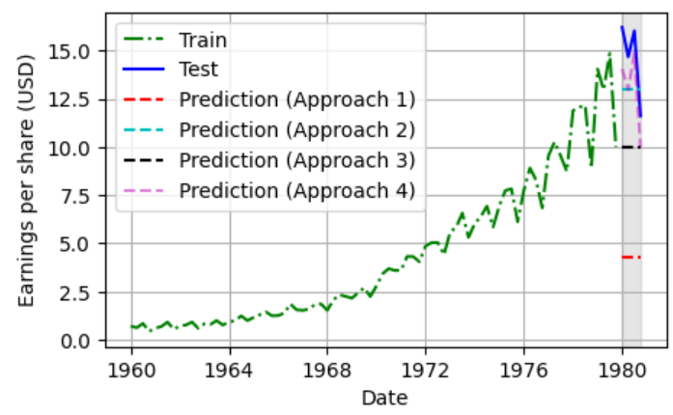
2.1 Defining a baseline model
A baseline model is the simplest possible way to make predictions.
It doesn’t need training and is very cheap to implement.
Common baseline methods include:
Mean method → Predict the average of past values (e.g., average EPS from 1960–1979 = $4.31, so forecast each quarter of 1980 as $4.31).
Last value method → Predict the next value will be the same as the most recent one (e.g., if EPS was $0.71 last quarter, forecast $0.71 for the next).
Seasonal repeat method → Repeat the same value from the same season/cycle in the past (e.g., Q1 1980 EPS = Q1 1979 EPS).
These baselines are not meant to be perfect. They give us a reference point to compare against more advanced models.
To test them, we make predictions for a period we didn’t use to build the baseline (like 1980 data) — this is called out-of-sample forecasting.
If advanced models can’t beat the baseline, they’re not useful.

Slide 7

3. Going on a random walk
This chapter covers
Identifying a random walk process
Understanding the ACF function
Classifying differencing, stationarity, and white noise
Using the ACF plot and differencing to identify a random walk
Forecasting a random walk
3.1 The Random Walk Process
A random walk is like taking steps where each move is unpredictable — sometimes up, sometimes down.
At each step, the new value depends on:
The previous value (where you were before),
A constant (which can push the walk steadily upward or downward — this is called drift),
And a random shock (a number drawn from a normal distribution, meaning it’s centered around 0 but can vary).
So the formula is:
y_{t}: value now
y_{t−1:} value from the last step
C: constant drift (if not zero, the walk tends to move in one direction over time)
ϵ_{t}: random noise (unpredictable ups and downs)

Slide 8
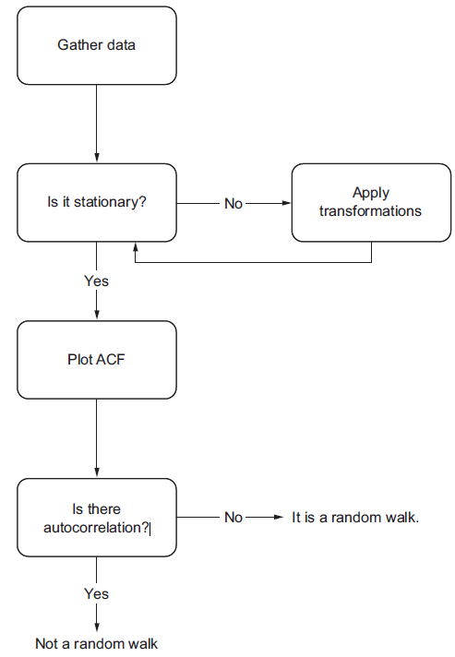
3. Going on a random walk
3.2 Identifying a random walk
A random walk is a series whose first difference is stationary and uncorrelated which means the ACF plot doesn’t have significant coefficients after lag 0.
This means that the process moves completely at random.
3.2.1 Concept of Stationarity
A stationary time series is one whose statistical properties do not change over time.
In other words, it has a constant mean, variance, and autocorrelation, and these properties
are independent of time.
Why Stationarity is important
If a series is not stationary that means it would have time varying statistical properties. Thus can’t find a function to forecast future value as a function of past values, since the coefficient would change at each point in time, aking forecast unreliable.
In real life there is hardly any stationarity series. Hence we need apply mathematical manipulation to the data that stabilizes its mean and variance, thus making it stationary
Linear differencing (removes trend): y’_{t} = y_{t} - y_{t-1}
Seasonal differencing (removes seasonality)
Log transformation stabilize variance.
Usually we don’t go beyond second order differencing

Slide 9
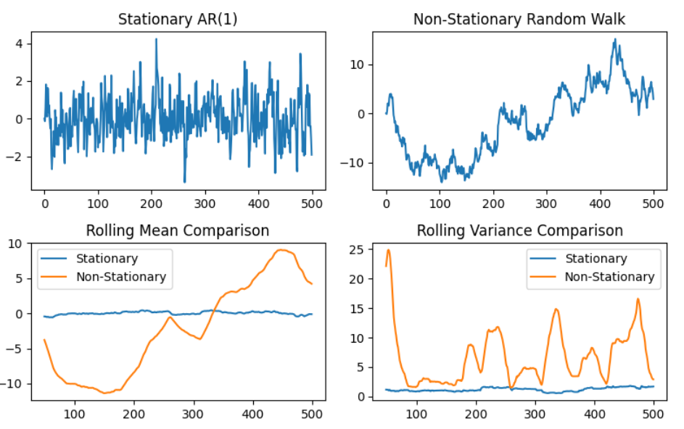

3. Going on a random walk
Testing for stationarity - Augmented Dickey-Fuller Test
Null hypothesis: unit root present in a time series.
Alternative hypothesis: no unit root, hence series is stationary.
Results of ADF test
Test statistics: more negative mean stronger evidence to reject null hypothesis
P value < 0.05, reject null hypothesis
Y_{t} = C + αY_{t-1} + ∊
If -1 < α < 1, is Y_{t} stationary
stationary
Non stationary

Slide 10
3. Going on a random walk
3.2.3 Autocorrelation Function
Autocorrelation measures linear relationship between lagged values of a time series
In ACF plot, the coefficient is the dependent & lag is the independent variable.
If series has trend, coefficients are high for short lags, and they will decrease linearly as the lag increases
2.3 Forecasting a Random Walk
Random walk basics: Each step is unpredictable. Future values depend only on chance.
Forecasting challenge: Since changes are random, no complex statistical model can beat simple guesses.
Naive methods (baselines):
Last value method: Predict the next value will be the same as the most recent one.
Historical mean method: Predict the average of past values.
Forecast horizon:
Best to forecast just the next step (short horizon).
If forced to forecast further, accuracy drops quickly because randomness builds up.
Stationary process with autocorrelation means means past values influence future ones
MA (Moving Average) → forecasts based on past random shocks.
AR (Autoregressive) → forecasts based on past values.
ARMA (Autoregressive Moving Average) → combines both AR and MA.

Slide 11
Forecasting With Statistical Model
Goal: Build models that capture patterns in data (trend, seasonality, autocorrelation).
Process:
Do hypothesis testing.
Study data properties.
Choose the best model.
Models we’ll learn:
MA(q) → Moving Average (based on past shocks).
AR(p) → Autoregressive (based on past values).
ARMA(p,q) → Combination of AR + MA.
ARIMA(p,d,q) → For non-stationary series
SARIMA(p,d,q)(P,D,Q)m → Adds seasonality.
SARIMAX → Adds external variables.
VAR(p) → For multiple time series together.
Other models (not covered in detail):
Exponential smoothing → Weighted average of past values (recent values matter more).
BATS/TBATS → Handle complex seasonality.
These are available in statsmodels library.
Capstone project: Apply all these models to real data.

Slide 12

Modeling a Moving Average Process
If a stationary series does show autocorrelation, we can use AR, MA, or ARMA models.
Steps to model:
Gather data.
Test for stationarity.
If not stationary → transform it (e.g., differencing).
Once stationary → plot ACF.
If ACF shows significant lags → not random walk → use MA model.
Defining a moving average process
A moving average process states that the current
value is linearly dependent on the current & past error terms.
The error terms are assumed to be mutually independent and normally distributed, just like white noise.
A moving average model is denoted as MA(q), where q is the order
μ: mean of the series
ϵ_{t}: present error term
ϵ_{t–q}: past error terms
θ_{q}: magnitude of the impact of past errors on the present value
The order q of MA model determines the number of past error terms that affect the present value
MA(2) can be described as

Slide 13
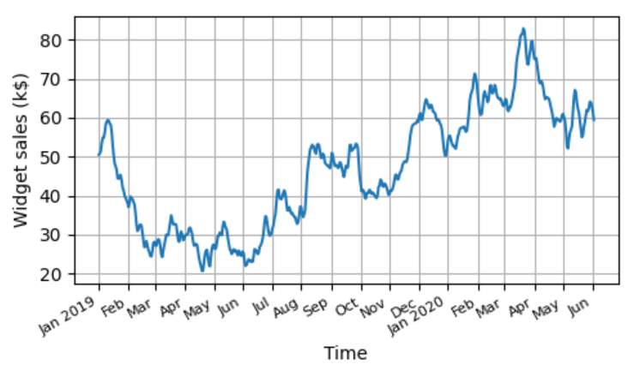
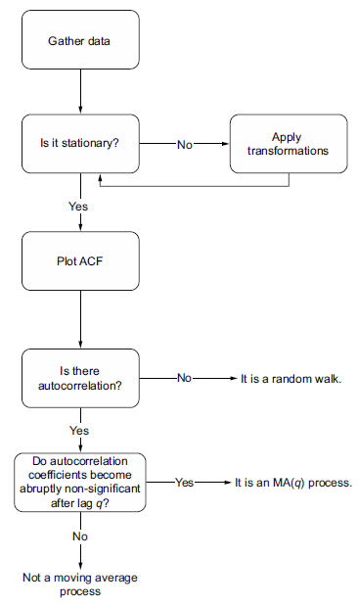
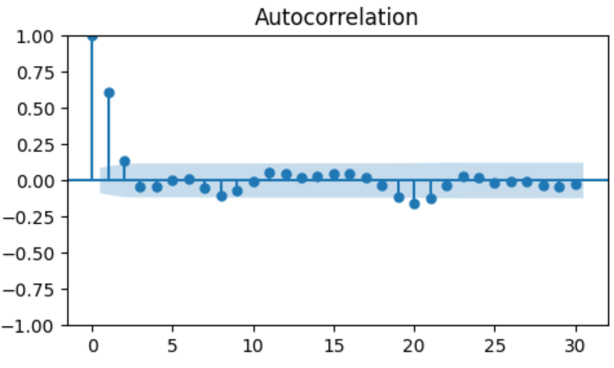
Modeling a Moving Average Process
4.1.1 Identifying the order of a moving average process
Since after lag 2, the coefficient become insignificant , hence this is MA(2)

Slide 14
Modeling a Moving Average Process
Key Limitation
MA(q) models depend on past error terms.
These error terms aren’t directly observed → they must be estimated step by step.
Because of this, you can only forecast up to q steps ahead in one shot.
Beyond q steps:
The model runs out of past error terms.
It then just predicts the mean → same as a baseline forecast.
So, forecasts beyond q steps add no real value.
Solution → Rolling forecasts: Forecast a few steps at a time, then update the training set with new data.
If the ACF plot of a stationary series shows a sinusoidal wave pattern, it suggests an autoregressive process.

